Slide 1

Introduction to Operating Systems CS/COE 1550
Spring 2022
Sherif Khattab
ksm73@pitt.edu
(Some slides are from Silberschatz, Galvin and Gagne ©2013)

Slide 2
Announcements
Lectures and recitations are back in-person
Upcoming deadlines
Homework 2 is due next Monday at 11:59 pm
Lab 1 is due on 2/4 at 11:59 pm
Project 1 is due on 2/18 at 11:59 pm
Explained in this week’s recitations

Slide 3
Previous Lecture …
Three-usage problems of Semaphores
compromising mutual exclusion
Solution: Mutex
deadlock
Solution: Not yet discussed
priority inversion
Solution: priority inheritance

Slide 4
Muddiest Points (basic concepts)
Deadlock
mutual exclusion

Slide 5
Muddiest Points (semaphore)
What the semaphore value means.
Can we see a process that utilizes a semaphore/spinlock and trace it?
Where we move after down is called

Slide 6
Muddiest Points (Mutex)
With mutex, what happens when a process tries to up() when it hasn't down()'d, does it skip over the instruction or does it do something else?
how does a mutex semaphore verify that the same process that called down on it in the first place is the one that called up on it?
Can a mutex have a negative value or is it only 0 or 1?
Advantages/disadvantages of Mutex

Slide 7
Muddiest Points (priority inheritance)
What is priority inheritance?
I'm confused on what the solution for priority inversion is or did we not mention it yet?
Does Priority Inheritance solve the Deadlock and Starvation problems along with the Priority Inversion problem?
Why running P1 in the priority inversion question not down the semaphore?
Does priority inversion (of semaphores) cause the lower process to run instead of the higher priority process indefinitely or does this resolve itself? If so how?

Slide 8
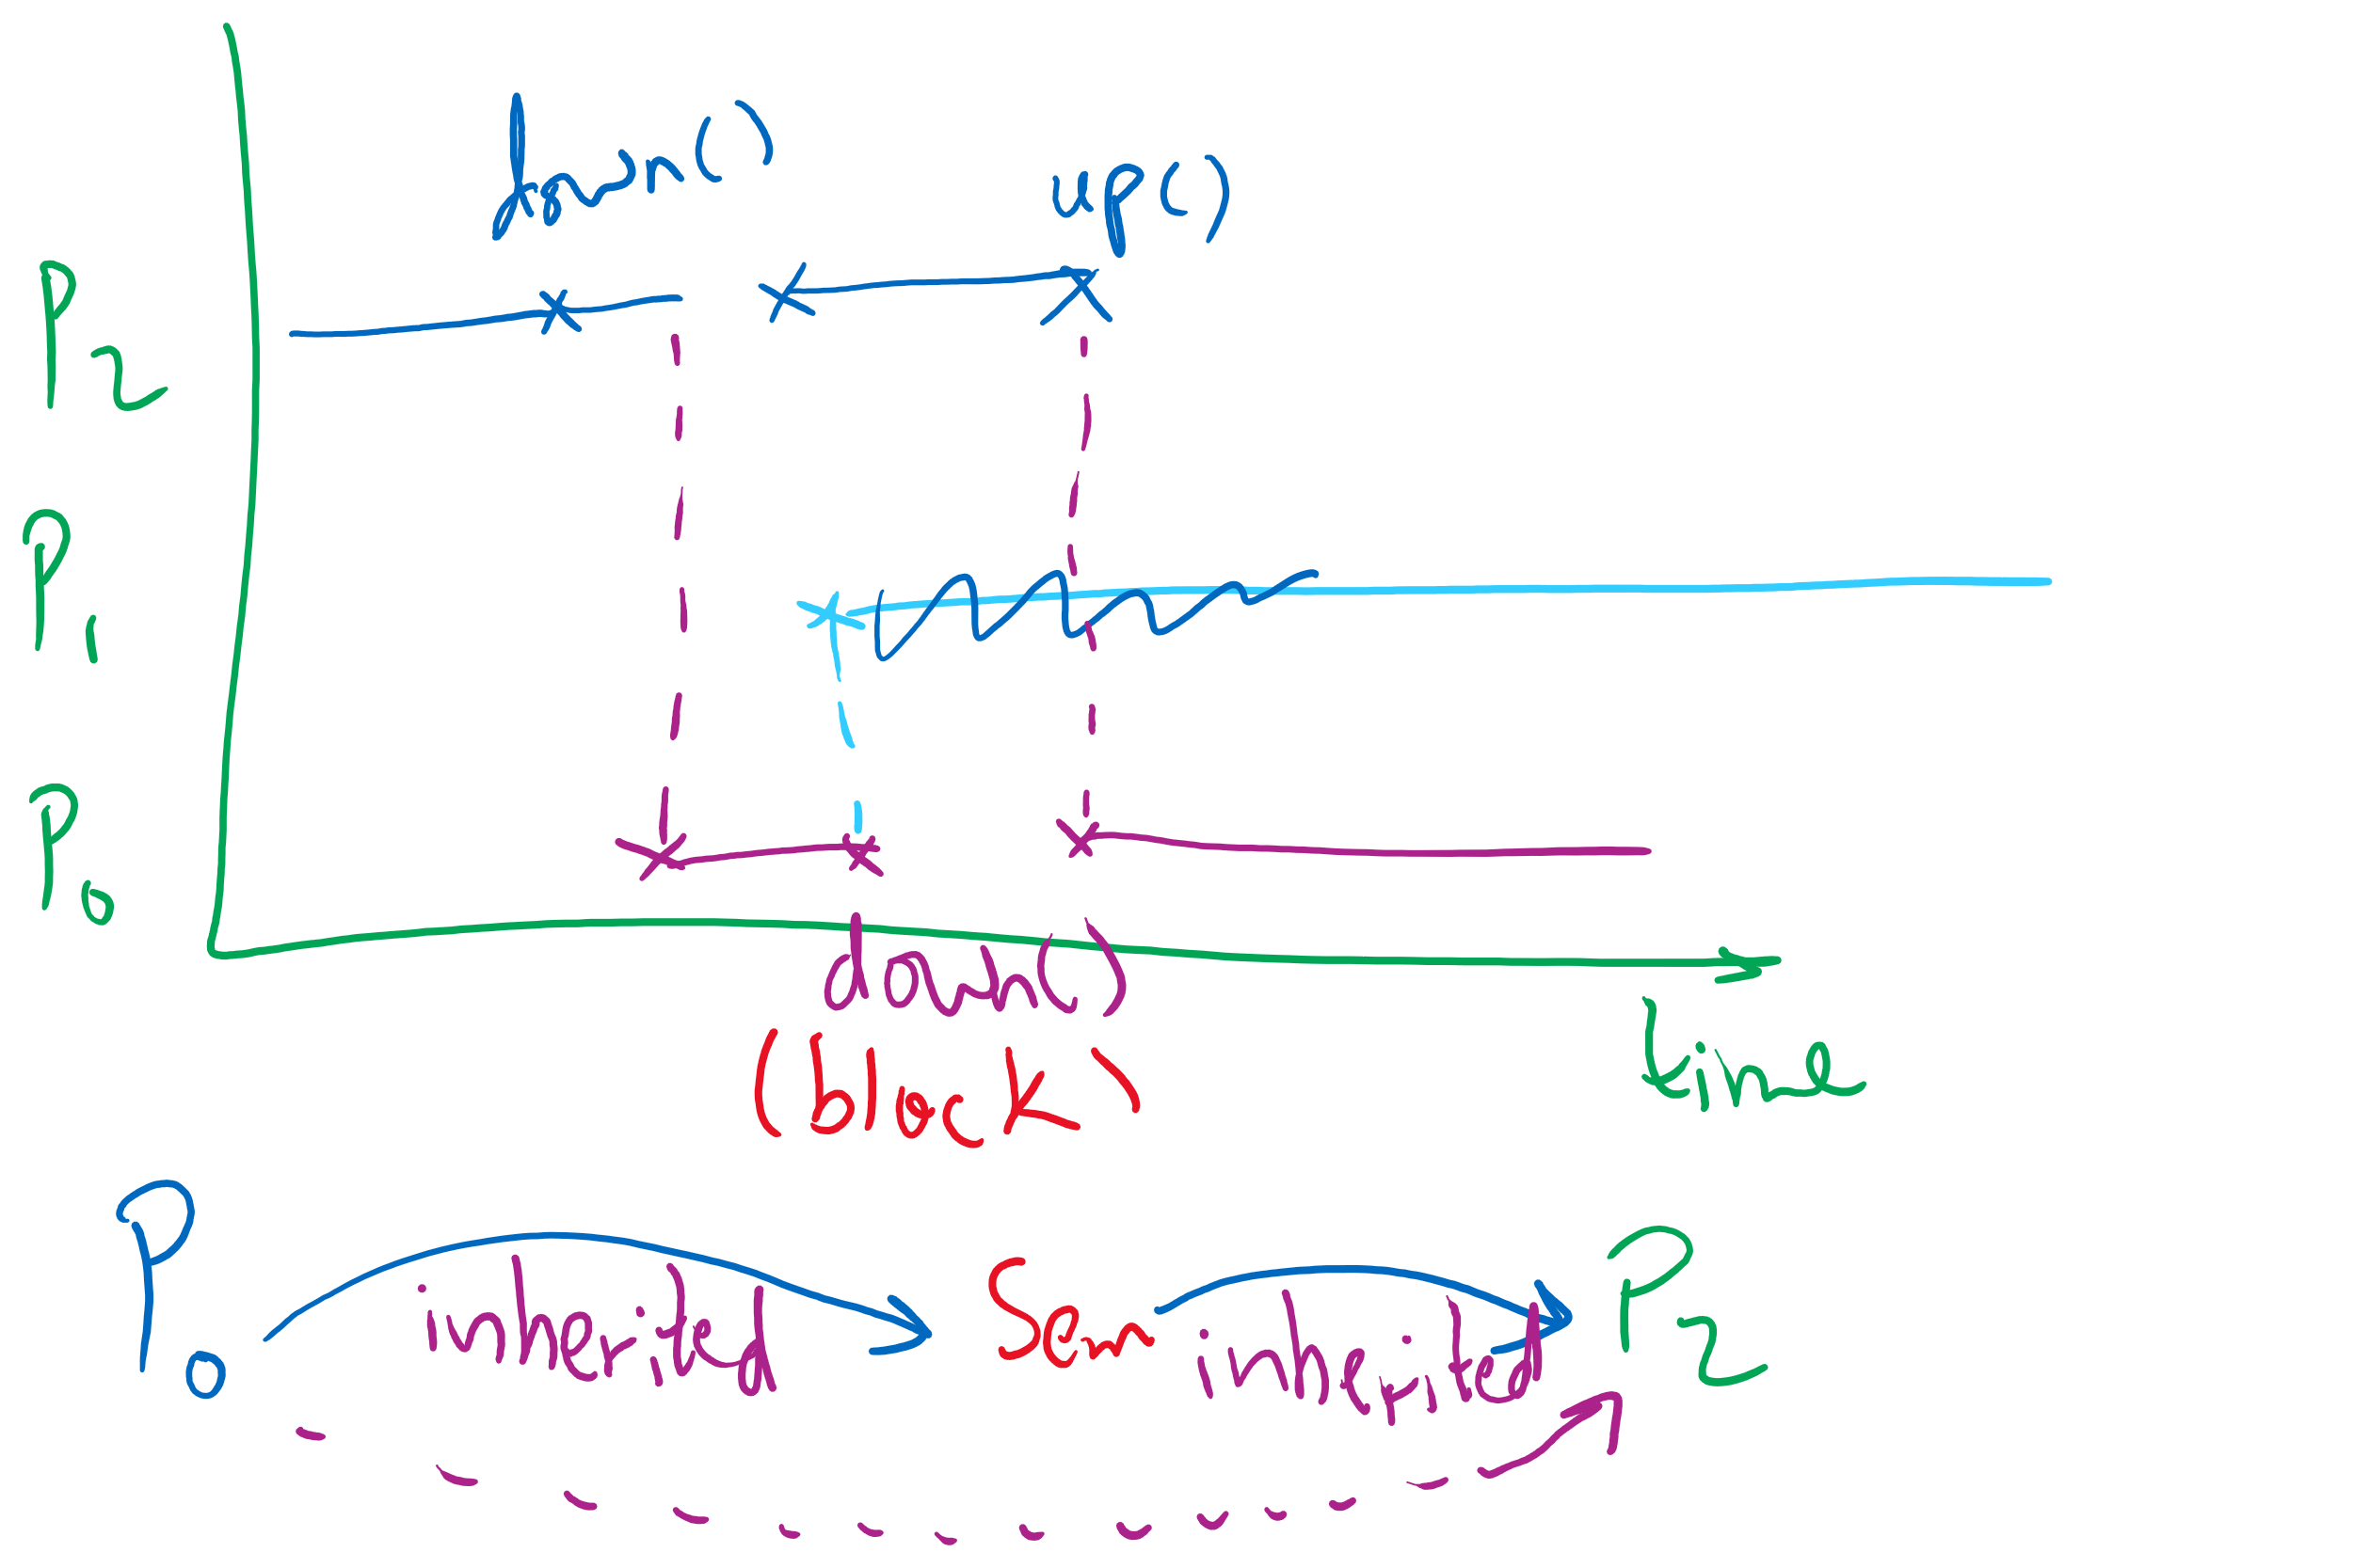
Semaphore Usage Problem: Priority Inversion

Slide 9
Muddiest Points (forking 1)
if fork creates copies of the process that called it, how can you tell which copy has priority to run first?
child processes & where they pick up in the code
Not exactly sure how semaphores are inherited between processes
In the last example, when p1 calls fork and creates the child p3, will p1’s PCB be copied to p3, which means the content of p0’s pcb will be in p3 too?
What is a PID and how is it related to the return value of fork()?
P3 is forked and created before P2 so why is it named P2? Is it simply renamed after P1 gets forked again?
Is the order of possible outcomes from a forking program the permutation of any of the leaf nodes from a forking tree?

Slide 10
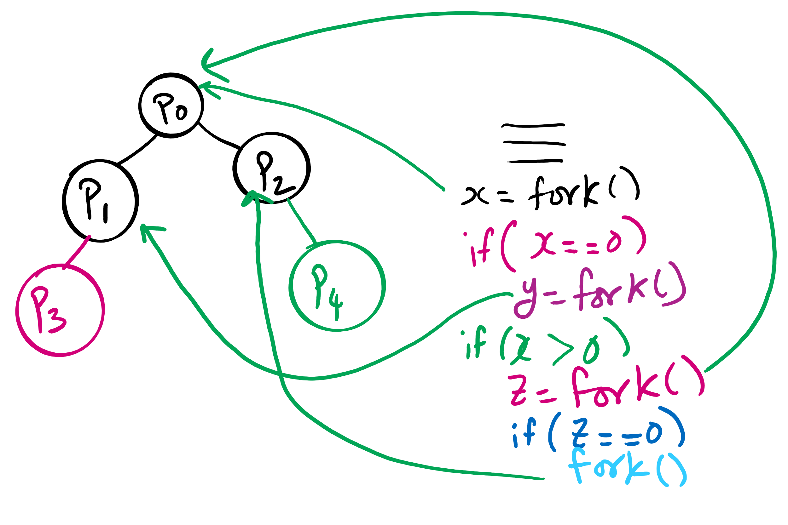
fork()’s of fork()’s

Slide 11
Muddiest Points (forking 2)
does the fork return zero for all children?
Somewhat confused about what order the various forks will actually form. I see why and from where they form, but not how it decides which one to run
how are all processes a fork of another process? i know the root of the tree is another process in the OS, but i don't get how for example a program you create and execute is a fork of something else.
the forking process with child processes. The relationship between the number of child processes created and the number of times fork() is called by the parent process
what int fork returns for the child and parent process
practical uses of forking?

Slide 12
Today’s Problem/Question
How are processes created and terminated?

Slide 13
Process Creation
Via fork() syscall
Parent process: the process that calls fork()
Child process: the process that gets created
Memory of parent process copied to child process
Too much copying
Even not necessary sometimes
e.g., fork() followed by exec() to run a different program
Optimization trick:
copy-on-write

Slide 14
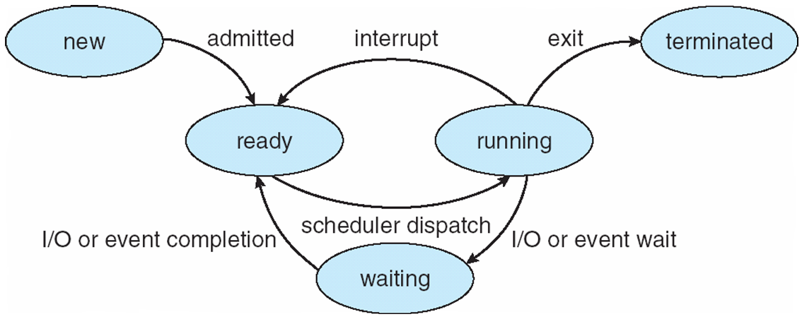
Process Lifecycle (AKA Process States)

Slide 15
Process Termination
Via exit(), abort(), or kill() syscalls
The parent process may wait for termination of a child process by using the wait()system call.The call returns status information and the pid of the terminated process
pid = wait(&status);
When a process terminates
If no parent waiting (did not invoke wait()) process is a zombie
If parent terminated without invoking wait , process is an orphan
adopted by the init process

Slide 16
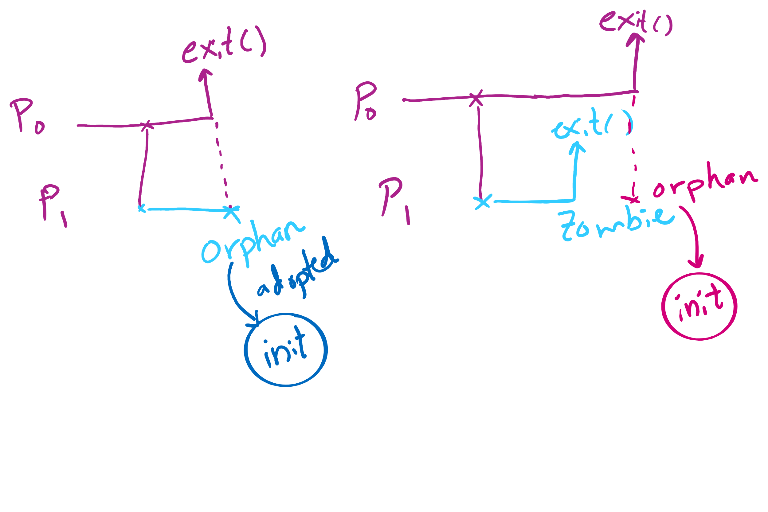
Orphan vs. Zombie Processes

Slide 17
Benefits of Orphan Processes
Allow a long-running job to continue running even after session (e.g., ssh connection) ends.
The nohup command does that
Create daemon processes
Long-running background processes adopted by the init process.

Slide 18
Xv6 Code Walkthrough
fork()
exit()
wait()

Slide 19
Process Lifecycle (AKA Process States)

Slide 20
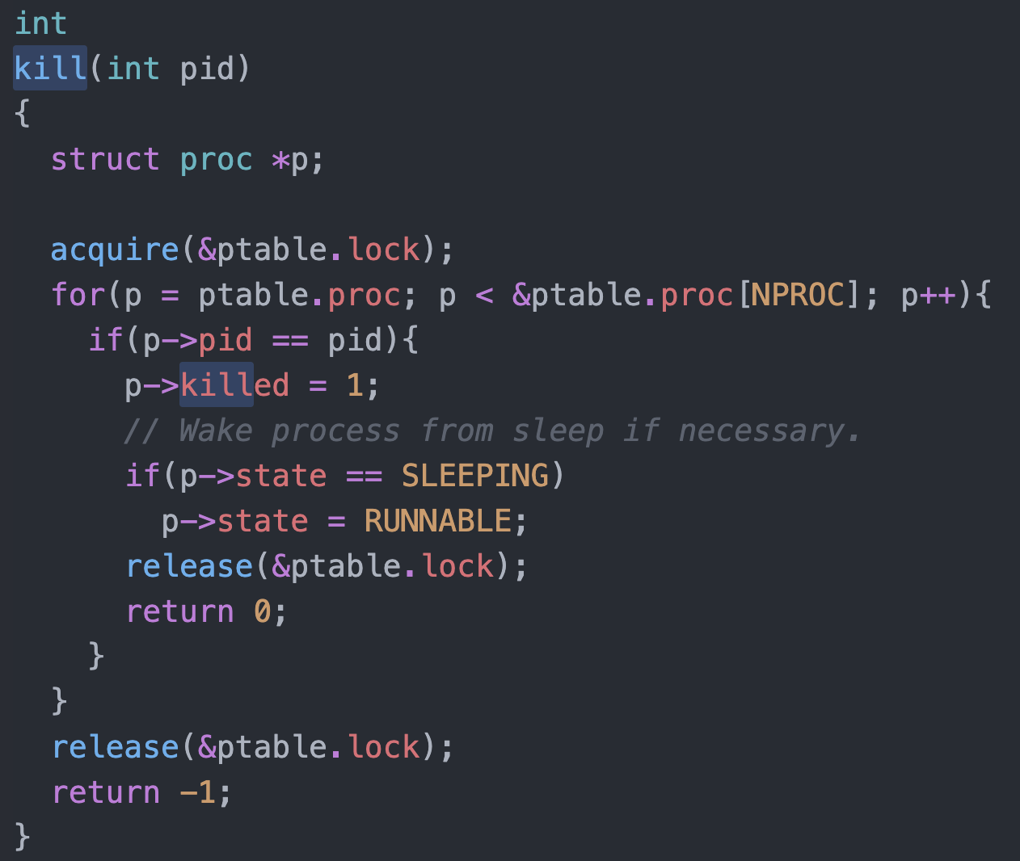
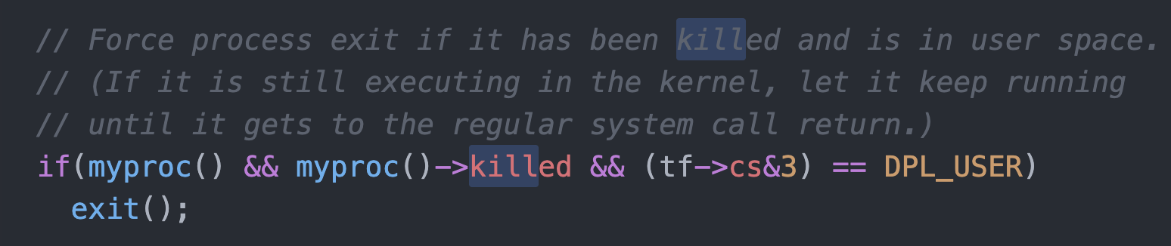
Killing a waiting process

Slide 21
Thread Synchronization
Synchronization issues apply to threads as well
Threads can share data easily (same address space)
Other two issues apply to threads

Slide 22
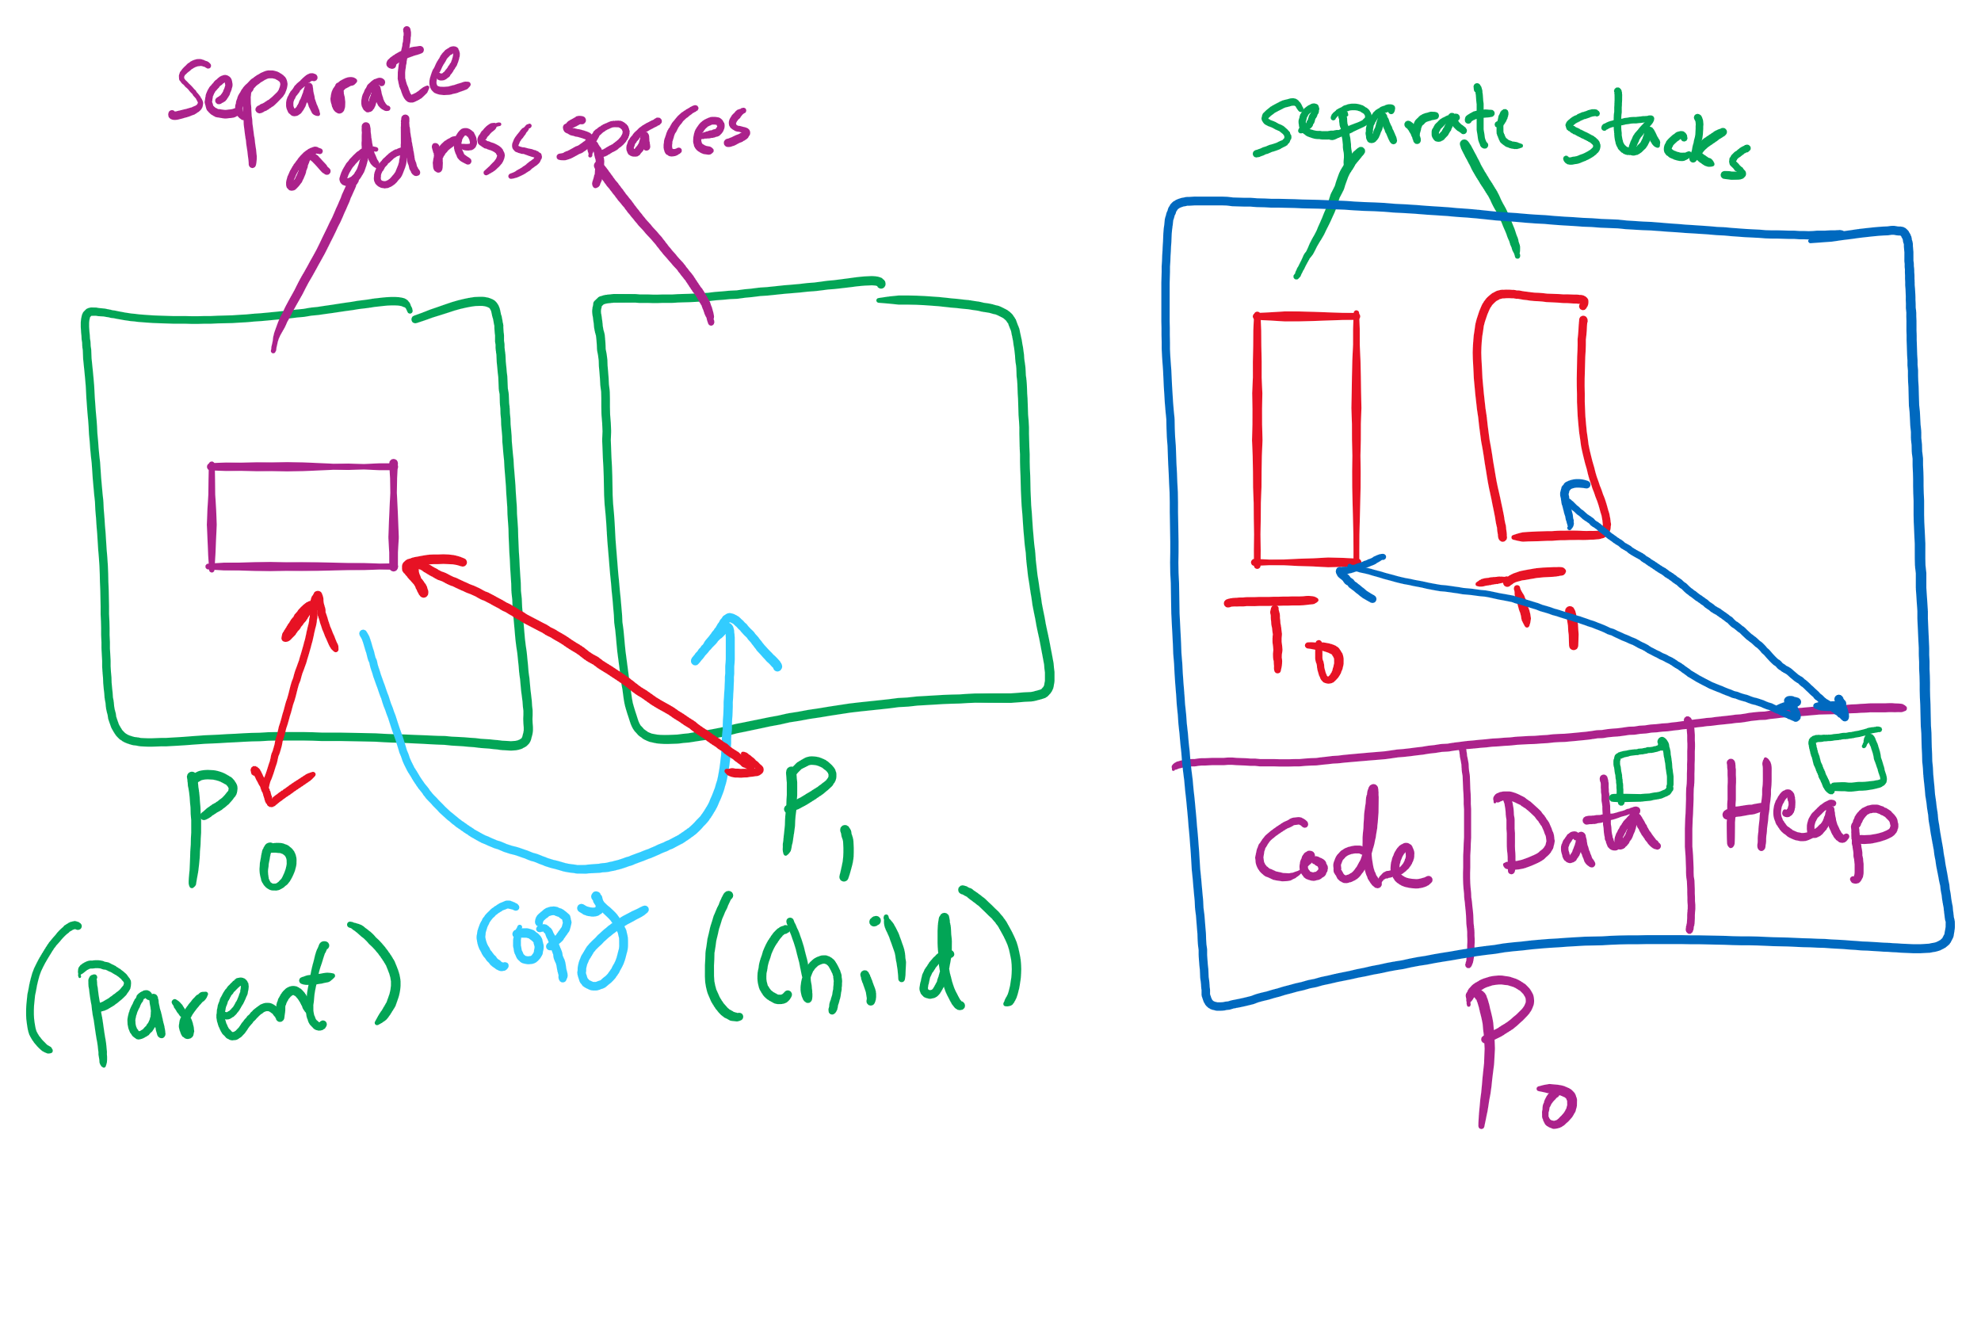
Process vs. Thread

Slide 23
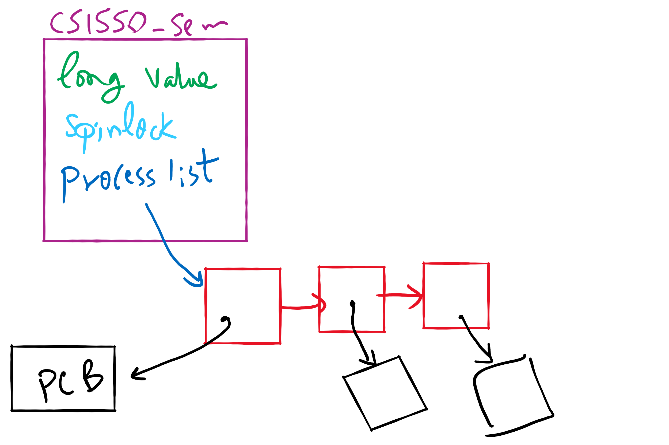
Semaphore Implementation in Project 1

Slide 24
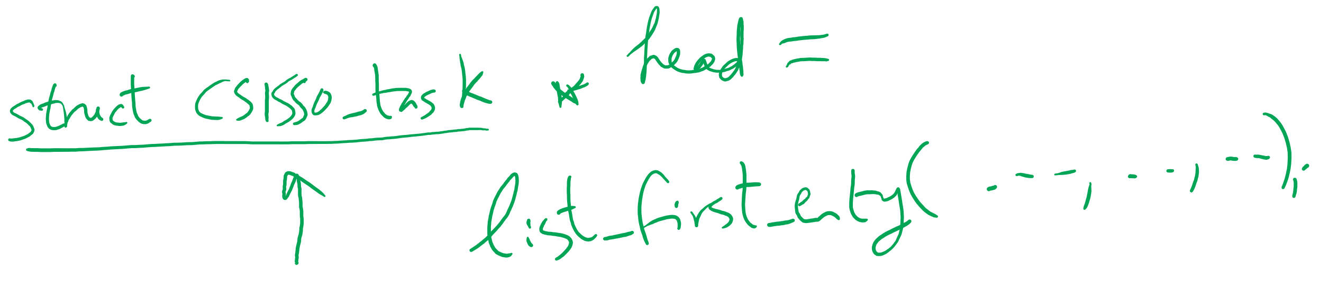
Getting the first entry in a list_head linked list

Slide 25
Why do we need Synchronization?
Each process operates sequentially
All is fine until processes want to share data
Exchange data between multiple processes
Allow processes to navigate critical regions
Maintain proper sequencing of actions in multiple processes

Slide 26
Semaphores for general synchronization
We want to execute B in P1 only after A executes in P0
Use a semaphore initialized to 0
Use up() to notify P1 at the appropriate time
Shared variables
// flag initialized to 0
Semaphore flag(0);
Process P₀
.
.
.
// Execute code for A
flag.up ();
Process P₁
.
.
.
flag.down ();
// Execute code for B

Slide 27
Monitors
A monitor is another kind of high-level synchronization primitive
One monitor has multiple entry points
Think multiple methods in a Java class
Only one process may be in the monitor at any time
Enforces mutual exclusion - less chance for programming errors
Monitors provided by high-level language
Variables belonging to monitor are protected from simultaneous access
Procedures in monitor are guaranteed to have mutual exclusion

Slide 28
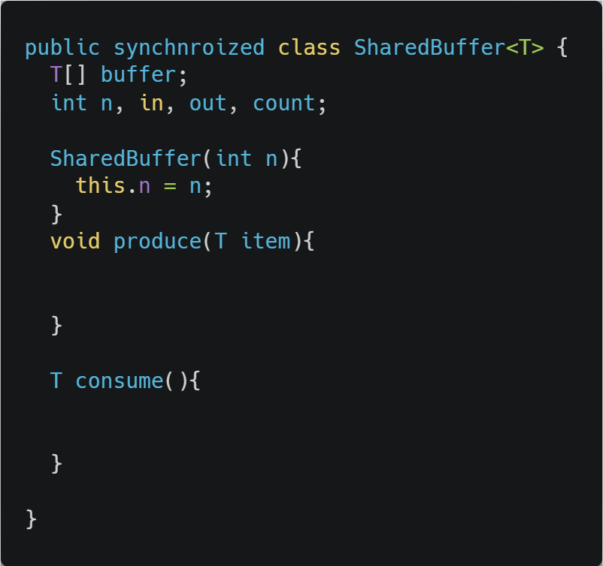
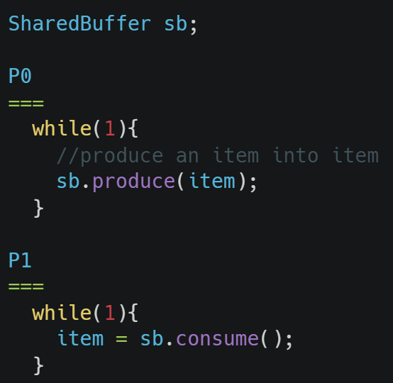
Monitor usage
Supported by Java
synchronized keyword
Only one process can be executing in either produce or consume at any time

Slide 29
Condition variables in monitors
Problem: how can a process wait inside a monitor?
Can’t simply sleep: there’s no way for anyone else to enter
Solution: use a condition variable
Condition variables support two operations
Wait(): suspend this process until signaled
Signal(): wake up exactly one process waiting on this condition variable
If no process is waiting, signal has no effect
Signals on condition variables aren’t “saved up”
Different from semaphores!
Condition variables are only usable within monitors
Process must be in monitor to signal on a condition variable

Slide 30
Locks & condition variables
Monitors require native language support
What if native support is not there (e.g., in C)?
Provide monitor support using special data types and procedures
Locks (Acquire(), Release())
Condition variables (Wait(), Signal())
Lock usage
Acquiring a lock == entering a monitor
Releasing a lock == leaving a monitor
Condition variable usage
Each condition variable is associated with exactly one lock
Lock must be held to use condition variable
Waiting on a condition variable releases the lock implicitly and reacquires the lock upon returning

